Slide 1
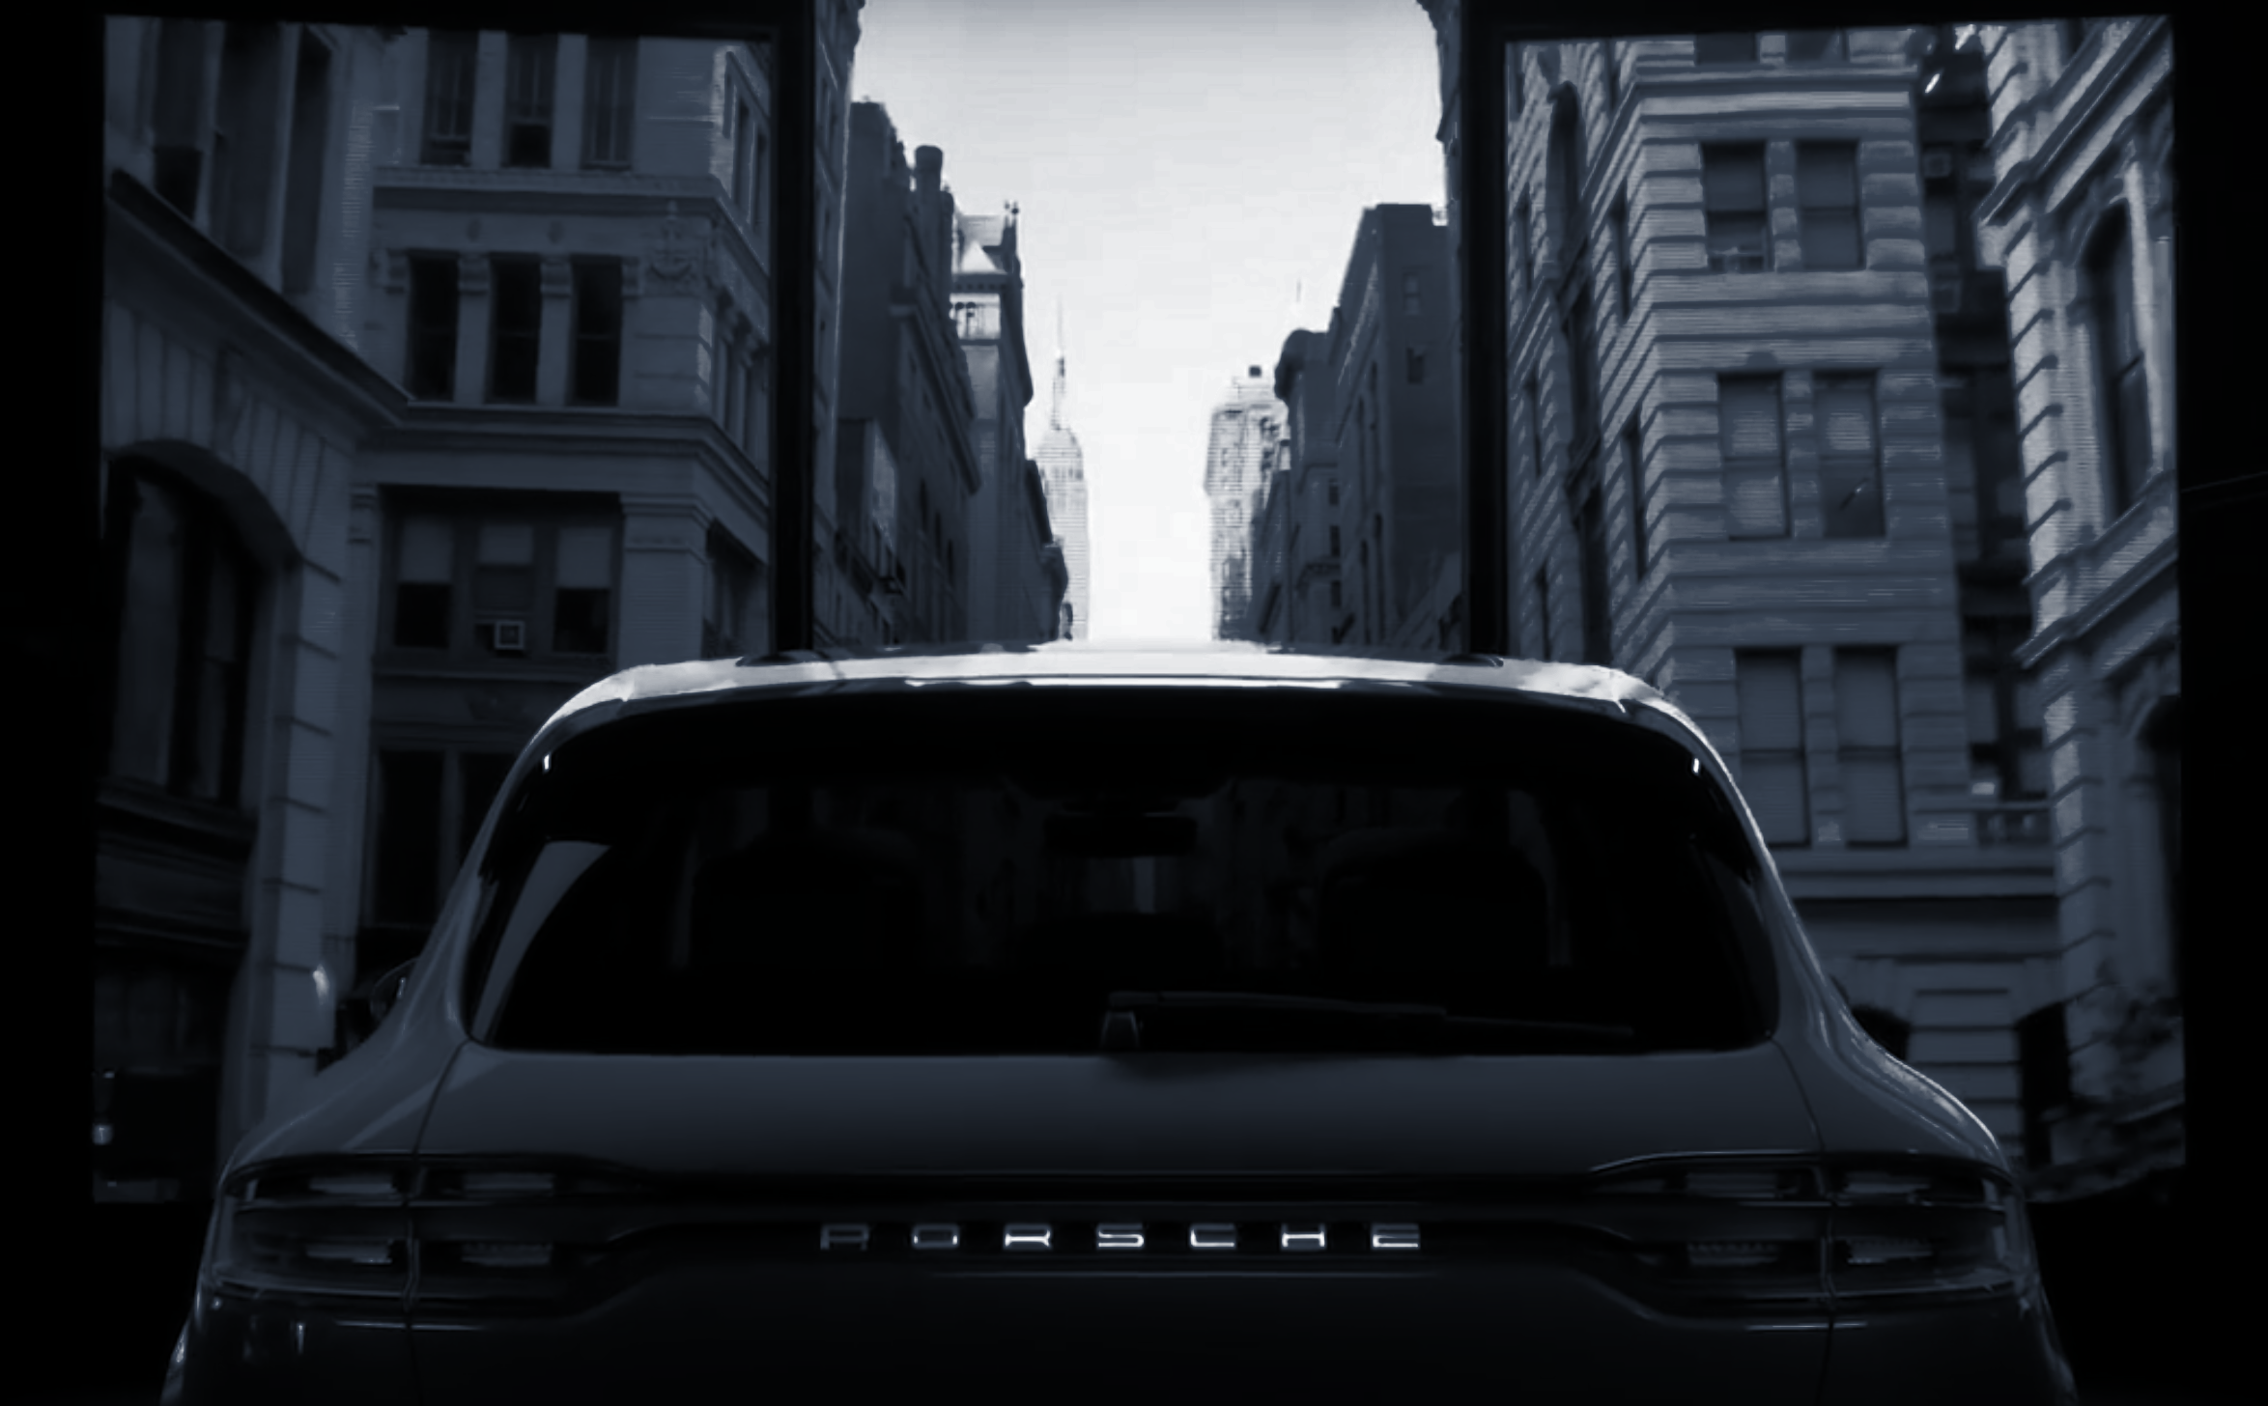

Porsche Electric Vehicle Offering Analysis
ATLytiCS Clean Air Hackathon - December 2019
Future of Mobility Team:
Jinny Kwon, jinheekwon710@gmail.com
Ange Ndema, andemapro@gmail.com
Charlotte Newman, charlotten22@gmail.com
Sai Satyashree, saisatyashreev@gmail.com
Notes:
welcome to the presentation on Porsche Electric Vehicle Offering Analysis.

Slide 2
Recap - Phase I
IDENTIFY
DATASETS
2.
Research issues
DEVELOP APPROACH
DEFINE BUSINESS NEED
RESEARCH THE PROBLEM
3.
Develop approach
Business Need: Convert existing U.S. Porsche customers and the target market to the EV model, in order to increase revenue and reduce greenhouse gas emissions.
Notes:
For Phase I of this project, we began by identifying our key business need and our approach to meeting that need. In order to maximize both profit and environmental impact, we decided to focus our approach on converting Porsche’s existing customers to the new EV model; however, we also recognize the need to expand Porsche’s customer base by reaching new consumers as well. In Phase I we outlined the ideal approach we would take to identify an optimal strategy to reach these new and existing customers. In this presentation, we’ll review the data that we accessed and analyzed and the recommendations we have for Porsche to successfully roll out their new EV car.

Slide 3





Phase II - Methodology
DATA COLLECTION
Data augmentation
DATA EXPLORATION
Data Visualization
INSIGHTS & IMPLEMENTATION
Marketing strategies
DATA PROCESSING
Cleaning
Formatting
DATA MODELING
Statistical Analysis
Notes:
We received a large quantity of data for this second phase of the project, but we needed to collect more to augment what we were given. After identifying useful data, we cleaned and formatted it, and then conducted initial data exploration and data visualization. We built models and ran statistical analysis, drew insights from that analysis, and crafted recommendations for Porsche’s EV rollout, including suggested marketing strategies.

Slide 4
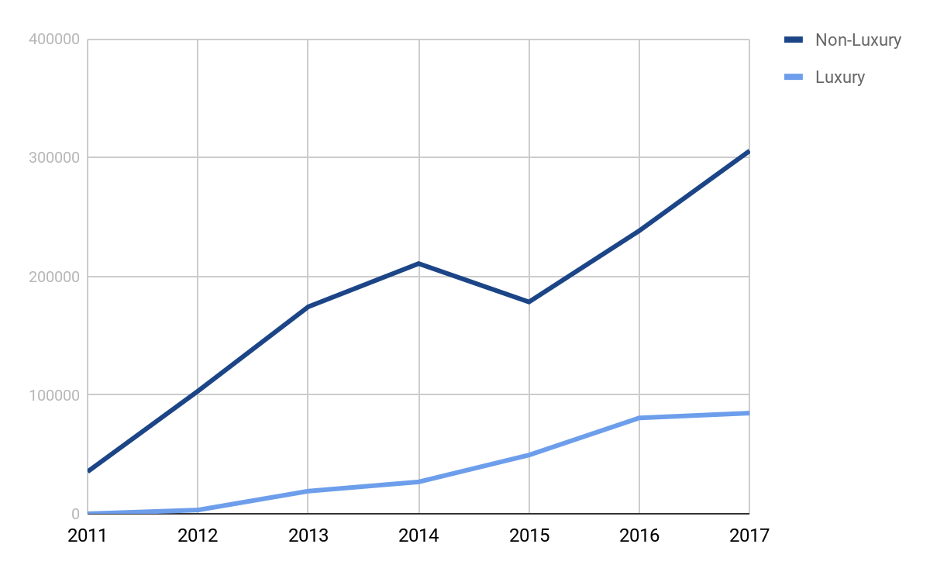
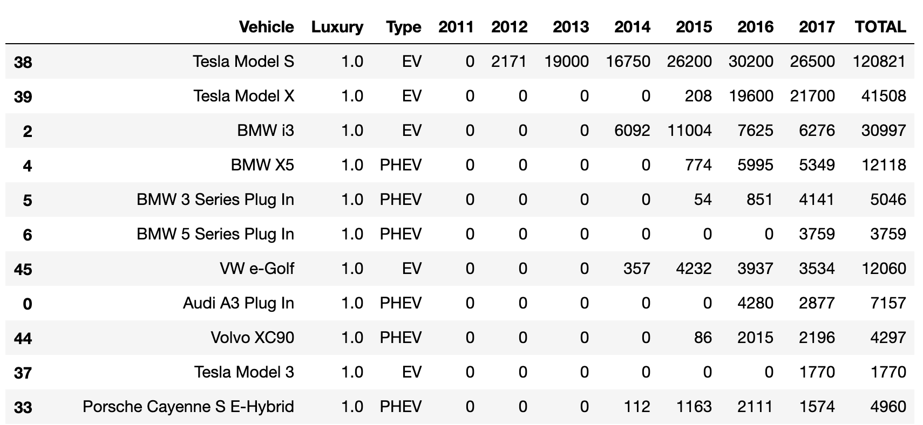
Market Overview
Luxury EV sales are increasing as more options emerge in the market.
Tesla and BMW are dominating the EV market (as of 2017).
Porsche’s current market share of all vehicles is 0.33%; its market share of EVs is 0.81%.
Luxury EV sales have been steadily increasing since their introduction in 2011.
EV Registration Count
Year
Notes:
Before we dive into our data, we want to set the stage with an overview of the electric vehicle market. EV sales have been steadily increasing as more and more options arrive to market. This is true for both non-luxury and luxury EVs - though luxury electric vehicles are much newer and were first introduced in 2011. Since then, Luxury EV sales have been steadily increasing. Because electric vehicles are a new technology, any automobile maker can compete for leadership of this new market by having innovative technology and strategic branding that meets market demand. This is an excellent opportunity for Porsche to become the next leader of the industry.
Tesla and BMW are currently dominating the luxury electric vehicle market with the top 6 best-selling cars as of 2017. However, Porsche’s customer base seems interested in purchasing a Porsche alternative fuel vehicle - this is demonstrated by the fact that although Porsche’s overall current automobile market share is 0.33%, it’s market share of alternative fuel vehicles is 0.81%. Porsche is well placed to become a leader of the luxury EV market.
http://carsalesbase.com/us-car-sales-data/porsche/

Slide 5
Target Consumer - Get to Know the Current EV Market
To understand the target consumer, we asked:
What geographical regions have the highest EV sales, and why?
What local factors might impact EV sales?
Who is buying (luxury) EVs?
What are the current trends in automobile sales?
Notes:
To begin our data exploration, we started by understanding the current electric vehicle market and current luxury EV consumers. To do this we looked for data on EV sales by geographical region, local factors that might or might not influence EV sales, and demographics of EV buyers.

Slide 6
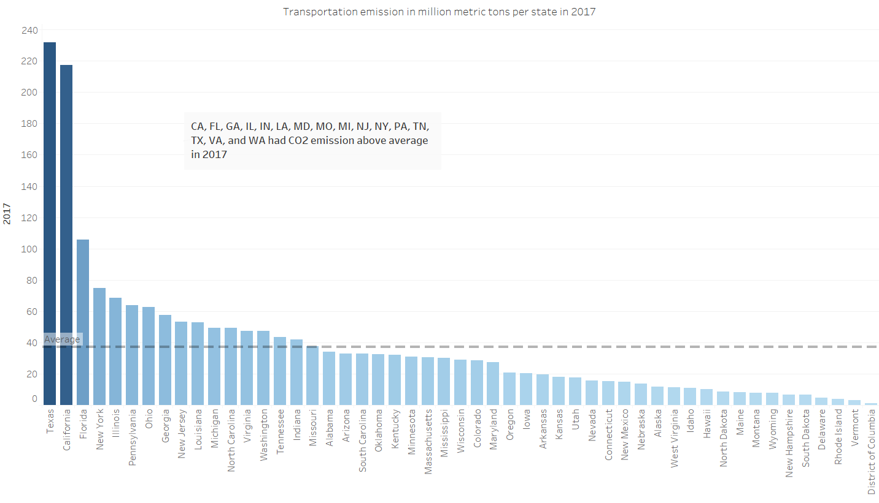
Target Consumer - Geographical Area
The top 6 states for EV registrations had above-average CO2 emissions in 2017.
EV Registration by State (2017)
State | Count | % Market
California | 179600 | 48.9%
Washington | 19900 | 5.4%
Florida | 16600 | 4.5%
Texas | 14390 | 3.9%
Georgia | 13530 | 3.7%
New York | 10940 | 3.0%
Arizona | 9820 | 2.7%
Oregon | 9550 | 2.8%
Illinois | 7950 | 2.2%
CO2 Emissions
State
Notes:
We started by exploring the states that had the highest and lowest EV sales, and tried to understand what factors might have the heaviest influence over these sales. EV sales are most heavily concentrated in the west coast, with 57% of the market being held in California, Washington, and Oregon. It’s important to note that nearly 50% of sales take place in California alone. However, EV sales are not exclusive to the west coast - when looking at total # of EV registrations, Florida, Texas, and Georgia are in the top 5 states.
To understand why some states rise above others in EV sales, we looked at local pollution indices, local incentives and regulations around electric vehicles, and the existing charging networks across the country. When looking at overall pollution index, we found that there was no correlation between that index and the state’s EV registrations - however, when we looked at just CO2 emissions - most of which are attributed to transportation - we noticed that there did seem to be a relationship. The top 6 states that had the highest EV registrations also had above-average CO2 emissions in 2017. However, there were ten additional states with above-average CO2 emissions that did not have a significant number of EV registrations, so we knew there had to be more to the story.
https://afdc.energy.gov/data/search?q=electricity

Slide 7
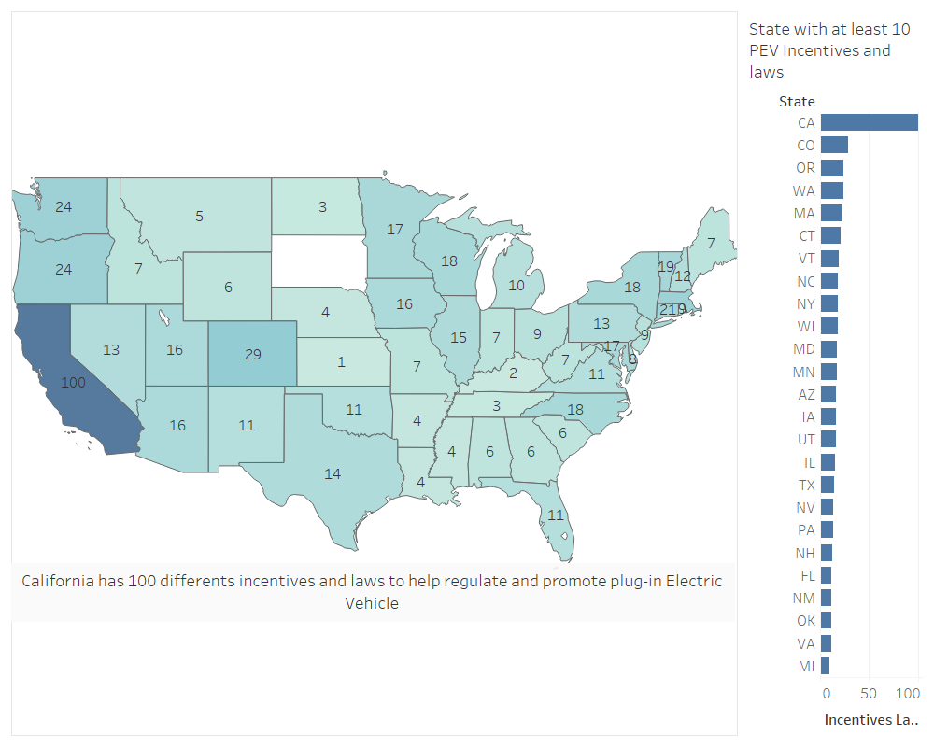
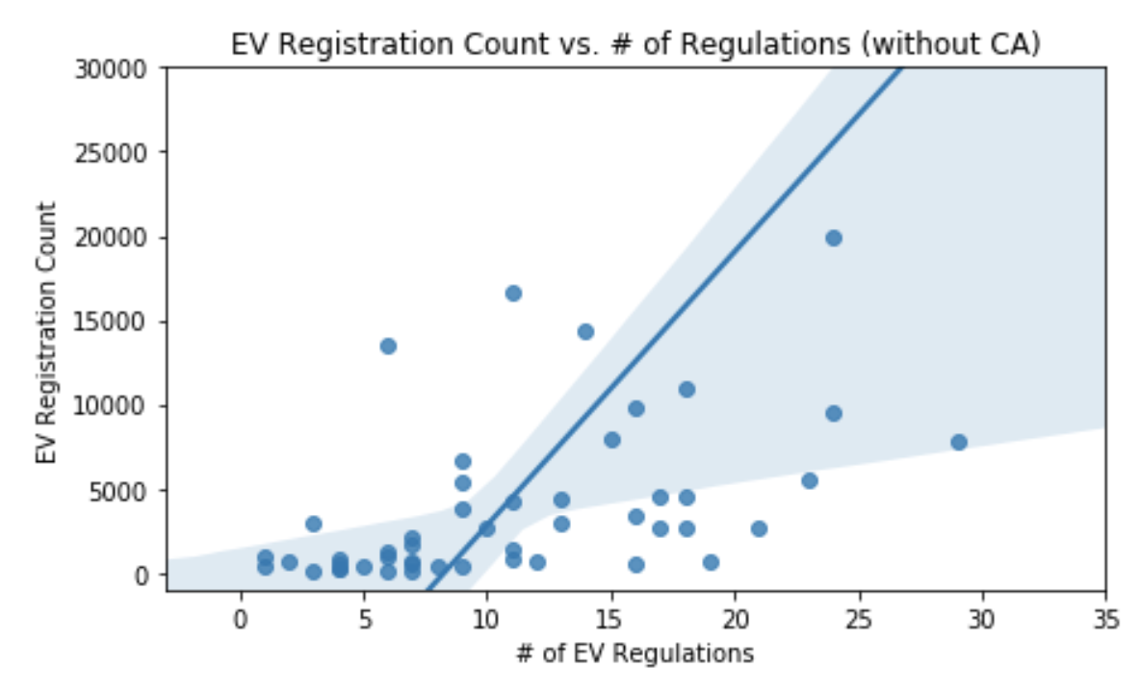
Target Consumer - Geographical Area
There does seem to be a correlation between a state’s EV regulations and incentives and it’s EV sales. The more EV regulations and incentives in a state, the more EV registrations there are.
# EV Laws and incentives, by State (Dec 2019)
EV Registration Count
Denotes state with top EV registrations
Notes:
To further understand this, we examined the number of laws and incentives in favor of electric vehicles, with the hypothesis that states with higher CO2 emissions might have more incentives, prompting more people to purchase electric vehicles. When looking at EV laws and incentives, there is a strong correlation between a state’s # of incentives and it’s total number of EV registrations. This indicates that when states offer incentives, consumers are more likely to purchase an electric vehicle.
We also see that when there are more regulations and incentives for EV, there’s a higher number of EV registration. This emphasizes an importance of state-led initiatives to bring awareness for EVs and the incentives it provides.
This could be an important point for Porshe’s EV marketing campaign.

Slide 8
Regulations and Incentives - NLP
Processing Regulations Text
The Most Popular Regulations:
Rebates for purchasing plug-in vehicles
Rebates for installing charging stations (both residential and commercial)
Grant for environmental related projects
ex) "The Wyoming Department of Environmental Quality (DEQ) is accepting grant applications for nitrogen oxide emissions reduction projects."
Rebates for mid- to heavy duty vehicles to replace alternative fuel vehicles
Task Force to increase EV infrastructures (Joint-state Initiatives)
Grouped popular Regulations and Incentives to 100 components using LSA.
Total Regulations: 665
n_Components Truncated: 100
Variance captured by all components: 63.8%
Notes:
To understand what types of regulations and incentives are most popular, we analyzed 665 Regulations related alternative energy vehicles. We used Latent semantic analysis or LSA to truncate the components to 100, and group the texts based on their similarities. We were able to capture 63.8% of all components.
The most popular regulations seem to be rebates for purchasing or replacing EVs and installing the charging stations. It is also interesting that some states offer grants for projects to reduce greenhouse gas emissions.
This shows an intricate relationship between state-wide initiatives to uplift burden of adopting new technology and the results in sales (??). By rewarding customers through rebates, improving EV related infrastructures, and investing in research to reduce greenhouse gas emission, it brings awareness for alternative energy vehicles and its positive effects on environment.
This knowledge is extremely helpful for Porsche to identify states that have these types of regulations and incentives - which may be the best starting points to launch a new EV. Alternatively, Porsche can consider how it can offer its own incentives to consumers in states that it wants to break into, but that might not have as supportive legislation.

Slide 9
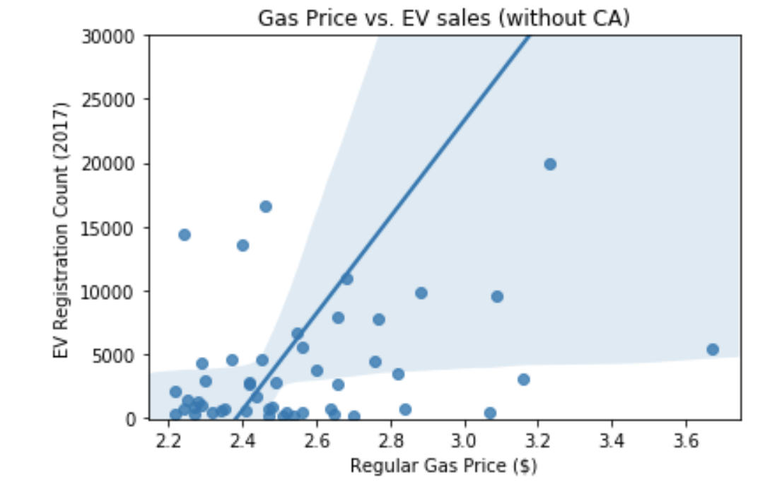
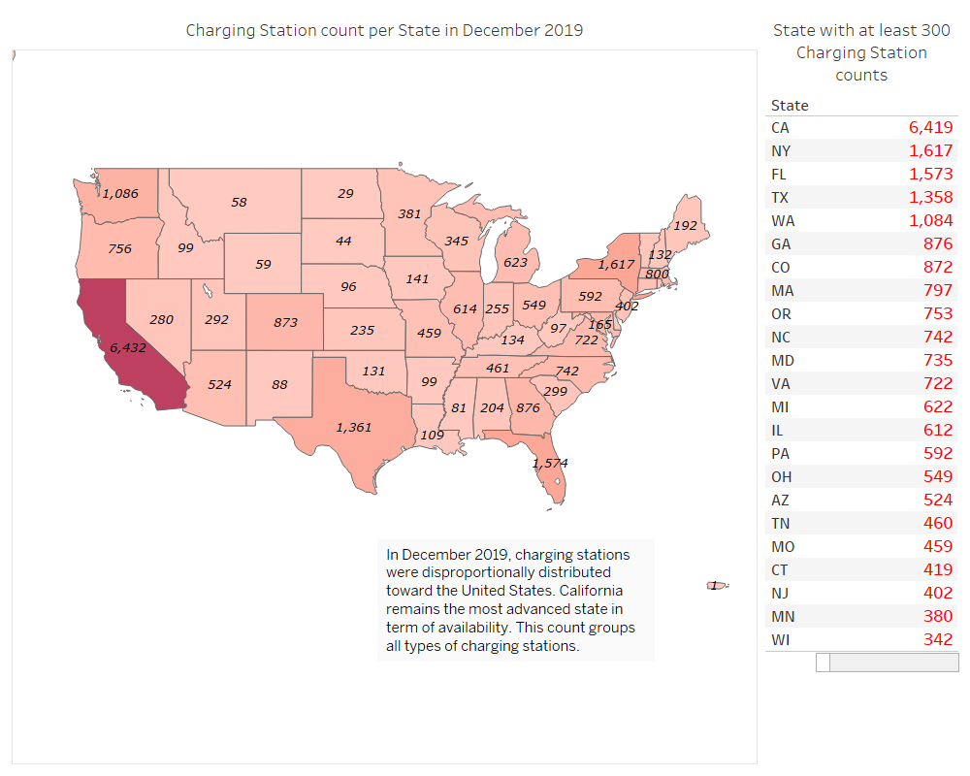
Target Consumer - Geographical Area
There is also a correlation between a state’s regular gas price and EV sales - the higher the price of gas, the more EV registrations there are.
Finally, there is a correlation between EV registrations and the # of EV charging stations in a given state. Unfortunately, we don’t know which came first.
EV Registration Count vs. Regular Gas Price ($)
# EV Charging Station count, by State (Dec 2019)
EV Registration Count
Regular Gas Price ($)
Denotes state with top EV registrations
Notes:
We also looked at the relationship between gas price and EV registrations, to see if areas with higher gas prices saw higher sales of EVs. In fact this hypothesis proved to be correct, as there is a clear correlation between an area’s gas price and the # of EV registrations. We theorize that consumers in these areas are drawn to EVs because of the lifetime savings in gasoline costs that they deliver. This is also an interesting point for Porsche to consider as part of its marketing strategy.
Finally, we explored the relationship between the number of EV charging stations and total EV registrations. Unsurprisingly, in areas with the highest number of registered EVs, we also see the highest concentration of charging stations. We don’t know whether the charging stations or the EV car sales came first - during our research in Phase I we learned that buyers often feel hesitant to buy an electric vehicle because of range anxiety, so having a robust EV charging network may help consumers feel more confident in buying an EV - thus driving up EV sales. Of course, it’s also possible that the high numbers of EV registrations also drove the demand for and therefore the supply of charging stations.

Slide 10
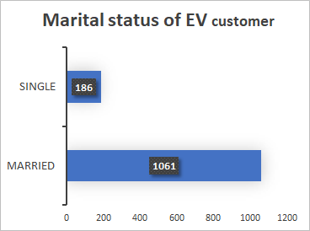
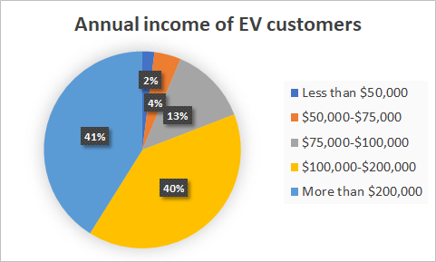
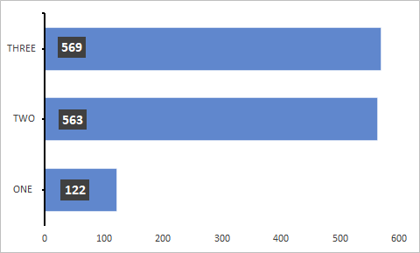
Target Consumer - Demographics
Approximately 80% of the EV customers in Maryland are married, and 45% have 3+ household members.
People with an annual income of >$100,000 are more likely to buy EVs.
Annual household income
Marital Status
# EV customers
Household Size
This data is from research performed on a sample of US - Maryland
# EV customers
Notes:
After looking at geographical location, we then wanted to better understand the demographics of the current EV market. What does the average EV consumer look like, and who should Porsche target?
A study conducted on EV owners in Maryland found that the average EV owner has an annual household income of $100,000 or more; they are likely to be married, and they nearly exclusively have a household size of two or more people.
https://www.motor1.com/news/300557/porsche-best-selling-models-2018/
https://www.caranddriver.com/features/g28829951/full-electric-cars-suvs-2019/

Slide 11
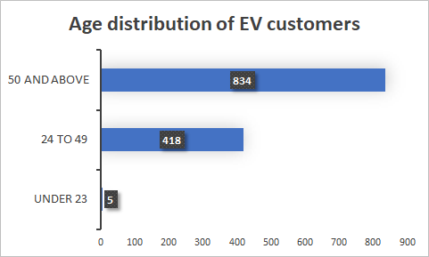
Target Consumer - Demographics
Currently, the majority of EV customers are aged 50 and above.
This data is consistent with the demographics of both Chevy Bolt and Tesla Model 3 consumers.
Chevy Bolt | Tesla Model 3
52% male, 48% female | 65% male
Millennials 18-34 | Millennials 18-34
53% married | 71% married
Mean HHI is $67,630 | Mean HHI is $102,040
But, studies show that millennials have been increasing significantly among the EV customer base (AAA).
Women account for 62% of new car sales
Audi’s Q3 (SUV) - 40% women, 65% of Q3 sales
*To optimize the market strategy we recommend collecting demographic data on Porsche consumers and the target market.
Notes:
Furthermore, the current age of the average EV customer is 50+, but studies show that millennials are steadily increasing within the EV consumer base. When we look at the consumer demographics for two electric vehicles - the Chevy Bolt and the Tesla Model 3 - we can see that this demographic information aligns with both vehicles’ customer bases - but especially with the customer base of the Tesla Model 3. Because both Tesla and Porsche offer luxury electric vehicles, we can assume that Tesla’s customer base is more similar to what Porsche can expect from its own target customers.
Interestingly, the Chevy Bolt has a more even male-female split among its consumers, whereas the Tesla Model 3 skews male. This is important because it indicates that women are interested in purchasing electric vehicles, but for some reason Tesla has missed this segment of the population with it’s marketing. When we examined current trends in the car market more broadly, we found that women account for 62% of new car sales, and influence 85% of car making decisions. Women also seem to be driving the demand for luxury SUVs - a case study for this is Audi - women only account for 40% of all Audi car sales, yet they make up 65% of consumers for Audi’s Q3 SUV model.
https://www.morgan.edu/Documents/ACADEMICS/CENTERS/NTC/Environmental%20Attributes%20of%20Electric%20Vehicle%20Ownership%20and%20Commuting%20Behavior%20in%20Maryland%20-%20Public%20Policy%20and%20Equity%20Considera.pdf
https://abcnews.go.com/Business/time-car-companies-wake-women-now-focus-industry/story?id=64087181

Slide 12
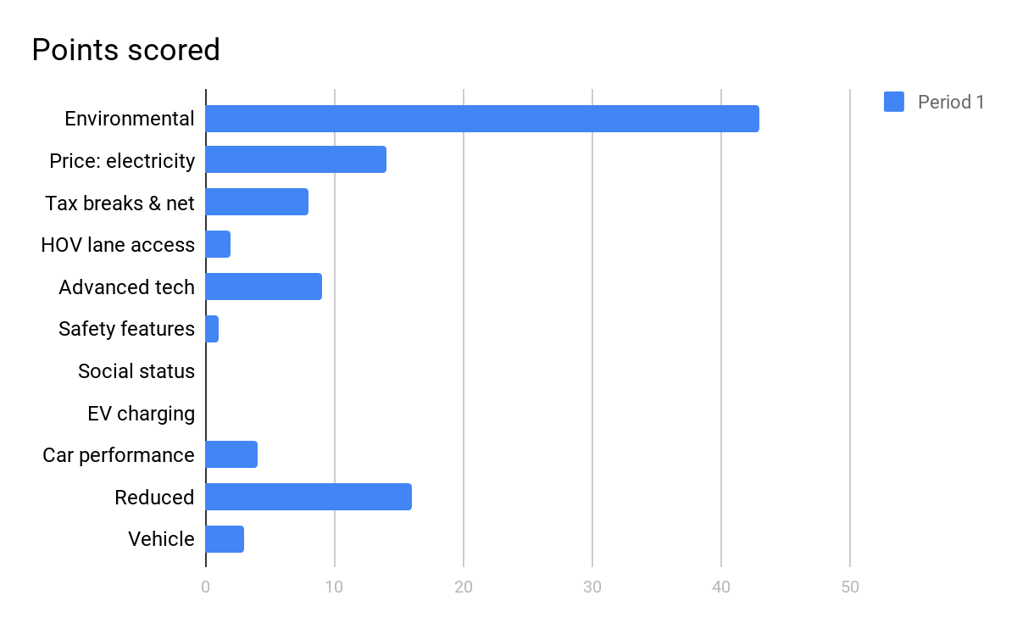
Target Consumer - Demographics
Environmental concerns
Price: electricity vs gas
Further, the Maryland study found the top 3 motivators for EV purchases were:
Concern for the environment
Desire for reduced dependency on petroleum
Reduced cost of electricity as compared to gas
Tax breaks & net price
HOV lane access
Advanced technology
Safety features
Social Status
EV charging network
Car performance
Reduced petroleum dependence
Vehicle make/model
# EV customers

Slide 13
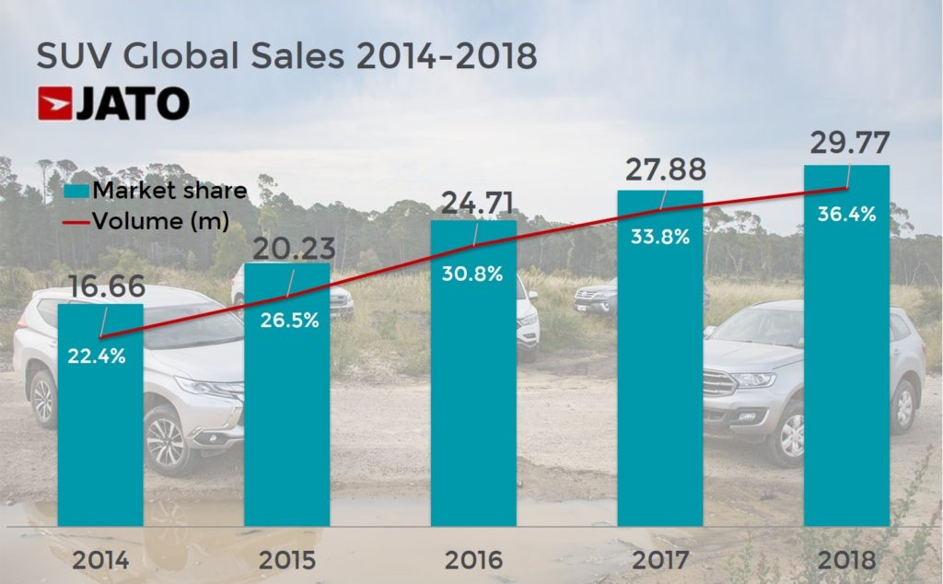
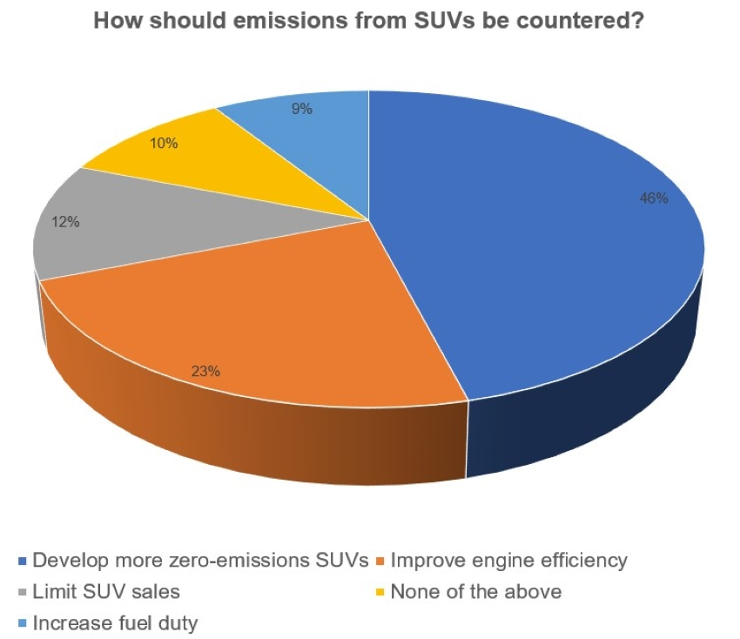
Market Trends - SUVs
SUV sales have been on the rise over the last 5 years
SUVs emit 25% more CO2 than a mid-sized car, and 46% of consumers believe the solution is to develop more zero-emissions SUVs.
9%
10%
12%
46%
23%
Notes:
Finally, we wanted to understand current trends in the auto market to make sure that Porsche’s EV offering aligns with what consumers are looking for.
SUV sales have been on the rise over the last 5 years (graph from http://carsalesbase.com/)
Consumer appreciation for both comfort and efficiency has resulted in increased demand for crossovers and hatchbacks
Porsche’s best-selling models are Macan and Cayenne - both SUVs; and Tesla’s Model X (SUV) has been very successful, as have the Chevy Bolt and Nissan Leaf (hatchbacks)
In recent auto shows, car makers announced that they will be launching plug-in SUVs.
Audi and BMW have announced the launch of their first SUV/hatchback EV models in 2020
As millennials enter into parenthood, SUV becomes a top choice for comfort, safety, and versatility.
However, There’s one challenge with SUV popularity - SUV vehicles are known to emit 25% more CO2 than mid-size car.
When scientists in UK took a poll for solution, consumers believe that the solution is developing zero-emissions SUVs.
Arguably, offering a zero-emission SUV is a way for Porsche to maximize its environmental impact - since the auto industry is trending towards SUVs, offering a zero-emission alternative can reduce CO2 emissions by 25% more than with a sedan EV.
https://www.motor1.com/news/300557/porsche-best-selling-models-2018/
https://www.caranddriver.com/features/g28829951/full-electric-cars-suvs-2019/
https://www.latimes.com/business/autos/story/2019-11-22/auto-show-electric-suvs https://www.theengineer.co.uk/poll-suvs-sports-utility-vehicles/

Slide 14
Target Consumer - Recommendations
SUV
Incentives & Regulation
Gas Prices
Target Consumers
Offer new models that reflect market trends such as SUV, crossover, or hatchback EV.
Focus on consumers in states with incentives and regulations that support EV sales*
Focus on areas with higher average gas prices, and create messaging around average cost savings in gas
Target millennials, family and women customers in current luxury vehicle market, emphasizing on comfort, safety, and environmental effects.
Notes:
Here is our recommendation in deciding target consumers.
As of 2019, the states with the top rebate incentives for EV car purchases are: Colorado, Connecticut, Delaware, Maryland, California, Massachusetts, Oregon, and New York. Based on our demographic information, Oregon and New York may be good target markets for Porsche because of the rebate packages offered.
https://cleantechnica.com/2019/04/20/electric-vehicle-incentives-in-8-us-states/

Slide 15
EV Charging Network
When deciding to purchase an EV, consumers worry about the available charging network (AAA). 75% of adults aged 55+ are less likely to buy an EV due to range anxiety (KPMG)
The average age of Porsche’s current consumer is >40, so it’s important for Porsche to address this concern.
# EV Charging Station count, by State (Dec 2019)
Notes:
Having a robust network of charging stations is important to recruit new buyers, since potential buyers often have concerns about where and when they can charge their vehicles. For cost efficiency, we recommend that Porsche refrain from using a proprietary charging system, in order to tap into the existing charging networks across the country. With this strategy, Porsche can focus its investment on installing charging stations in states with growing EV markets but less robust charging networks, such as Georgia, Florida, Texas, and New York.
To better understand where to place these charging stations, it’s important to understand the driving lifestyles of potential consumers. The Maryland study shows that the vast majority of EV drivers are commuting between city and suburban areas, so Porsche should focus on increasing the available charging networks in these heavily trafficked routes.
https://www.morgan.edu/Documents/ACADEMICS/CENTERS/NTC/Environmental%20Attributes%20of%20Electric%20Vehicle%20Ownership%20and%20Commuting%20Behavior%20in%20Maryland%20-%20Public%20Policy%20and%20Equity%20Considera.pdf

Slide 16
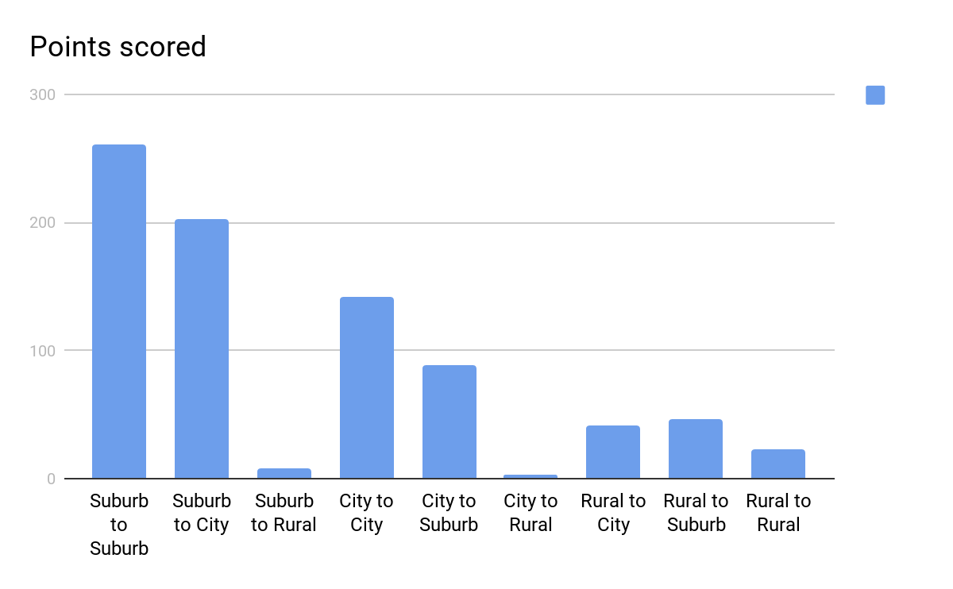
EV Charging Network
Most EV drivers commute in and between cities and suburban areas.
Studies show that 80% of EV charging happens at home.
As such, Porsche should consider offering rebates on home installation of Level 1 and Level 2 EVSE chargers for Porsche buyers.
# EV Consumers
EV Driver Commute (Maryland)
Notes:
Having a robust network of charging stations is important to recruit new buyers, since potential buyers often have concerns about where and when they can charge their vehicles. For cost efficiency, we recommend that Porsche refrain from using a proprietary charging system, in order to tap into the existing charging networks across the country. With this strategy, Porsche can focus its investment on installing charging stations in states with growing EV markets but less robust charging networks, such as Georgia, Florida, Texas, and New York.
To better understand where to place these charging stations, it’s important to understand the driving lifestyles of potential consumers. The Maryland study shows that the vast majority of EV drivers are commuting between city and suburban areas, so Porsche should focus on increasing the available charging networks in these heavily trafficked routes.
Furthermore, a study from the Department of Energy found that 80% of EV charging actually happens at home.
https://www.morgan.edu/Documents/ACADEMICS/CENTERS/NTC/Environmental%20Attributes%20of%20Electric%20Vehicle%20Ownership%20and%20Commuting%20Behavior%20in%20Maryland%20-%20Public%20Policy%20and%20Equity%20Considera.pdf

Slide 17
Charging Network - Recommendations
Offer non-proprietary chargers to reduce cost and tap into existing charging networks
Install new chargers in states with increasing EV sales that don’t yet have robust charging networks
Consider free or discounted home charging installation to gain new buyers
Notes:
Based on the data, we have the following recommendations for Porsche’s target demographic:
Charging network strategy should be robust enough to ease consumer concerns; however, due to the cost of installing and maintaining chargers, we recommend using non-proprietary chargers to tap into the existing network of charging stations.
We recommend focusing the installation of new charging stations in states that have increasing EV sales but don’t yet have a robust charging network - this is part of a strategy to gain new buyers.
Studies show that 80% of charging occurs at home (DoE), so Porsche should consider providing free or discounted installation of home charging stations

Slide 18
Marketing Strategy
01
Customer Profile I
Current Luxury Car Owners
General luxury car owners
Porsche’s white glove service to install charging stations at home
Keywords: design, convenience, and innovation
02
Customer Profile II
Family & Women
Family and women drivers
Zero-emission SUV that comes with comfort, safety, and style
Keywords: comfort, safety, environmentally friendly
03
Customer Profile III
Millennials
Millennials with income higher than $100,000
Versatile SUV that you can drive anywhere, equipped with innovation and comes with zero-emission
Keywords: innovation, environmentally friendly, versatility
04
Customer Profile IV:
Geo-specific Customers
Luxury car owners in key states with high incentives for EV
Emphasize rebate (reward) and convenience that comes with improved infrastructures
Keywords: future, convenience, reward
Notes:
Based on our analysis, we identified four specific types of customer profiles that Porsche can effectively target for marketing implementation. Under an assumption that there will be an electric SUV by Porsche,
The first group is current luxury car owners: Key message to communicate is Porsche’s white glove service to install charging stations at home to address their concern for transitioning to EV with an emphasis on long mile range with a full battery. The values to focus on are design, convenience, and innovation for this group.
The second group is family and women. For this group, have a warmer tone of voice with a message the vehicle is Zero-emission SUV that comes with comfort, safety, and style. It’s good for them, good for the environment and good for the future. The key values to focus on are comfort, safety, and environmentally friendly SUV.
The third group is millennials with income over $100,000. To this group, we want to communicate the versatility of SUV that you can drive anywhere. Emphasize that the vehicle is equipped with cutting edge technology and emits with zero-emission, which is an important value to many millennials. The values we want to communicate are innovation, environmentally friendliness and versatility.
Lastly, we can implement geo-specific marketing activities for those who live in the states with high incentives. Emphasize how the state is improving environment for EVs and how it affects them directly. Focus on the reward aspect such as rebates and comfort of close proximity to charging station. Let them know that they can join this movement to pioneer into future of mobility.

Slide 19
Summary
To maximize both earnings and environmental impact, Porsche should:
Offer an SUV electric vehicle, which is an increasingly popular model and emits 25% more CO2 than a mid-size car
Target consumers in states that have incentives and regulations that support EV sales
Especially rebates for vehicles or charging station installation
In emerging market states that don’t offer these incentives, Porsche should consider offering them independently
Target states with higher average gas prices, and create messaging around lifetime cost savings
Market to millennials, especially families and women - place emphasis on safety, comfort, and environmental impact
Offer nonproprietary chargers to maximize consumer ease and reduce Porsche cost
Install new chargers in emerging market states that don’t yet have a robust charging network
Especially in urban and suburban areas

Slide 20
Thank you!
Sources:
http://carsalesbase.com/us-car-sales-data/porsche/
https://afdc.energy.gov/data/search?q=electricity
https://www.morgan.edu/Documents/ACADEMICS/CENTERS/NTC/Environmental%20Attributes%20of%20Electric%20Vehicle%20Ownership%20and%20Commuting%20Behavior%20in%20Maryland%20-%20Public%20Policy%20and%20Equity%20Considera.pdf
https://abcnews.go.com/Business/time-car-companies-wake-women-now-focus-industry/story?id=64087181
https://www.motor1.com/news/300557/porsche-best-selling-models-2018/
https://www.caranddriver.com/features/g28829951/full-electric-cars-suvs-2019/
https://www.latimes.com/business/autos/story/2019-11-22/auto-show-electric-suvs https://www.theengineer.co.uk/poll-suvs-sports-utility-vehicles/
https://cleantechnica.com/2019/04/20/electric-vehicle-incentives-in-8-us-states/
Notes:
http://carsalesbase.com/us-car-sales-data/porsche/
https://afdc.energy.gov/data/search?q=electricity
https://www.morgan.edu/Documents/ACADEMICS/CENTERS/NTC/Environmental%20Attributes%20of%20Electric%20Vehicle%20Ownership%20and%20Commuting%20Behavior%20in%20Maryland%20-%20Public%20Policy%20and%20Equity%20Considera.pdf
https://abcnews.go.com/Business/time-car-companies-wake-women-now-focus-industry/story?id=64087181
https://www.motor1.com/news/300557/porsche-best-selling-models-2018/
https://www.caranddriver.com/features/g28829951/full-electric-cars-suvs-2019/
https://www.latimes.com/business/autos/story/2019-11-22/auto-show-electric-suvs https://www.theengineer.co.uk/poll-suvs-sports-utility-vehicles/

